Slide 1
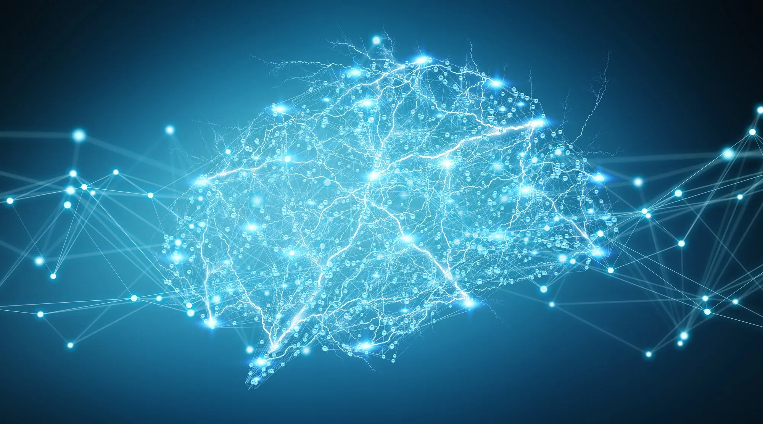
DL201+
A Deep Learning Workshop
Day 2
Benjamin Chew | Kok Zhao Jie | Shaun Tieon

Slide 2
Overfitting - How to reduce?

Slide 3
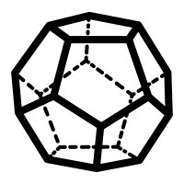

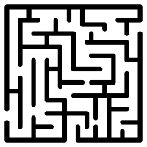

Techniques to reduce overfitting
Regularization refers to a set of different techniques that lower the complexity of a neural network model during training
3 main regularisation techniques:
L1 Regularisation
L2 Regularisation
Dropout

Slide 4

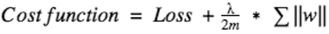
L1 & L2 Regularisation
These update the general cost function by adding another term known as the regularization term.
Regularisation term differs in L1 and L2
L2 regularisation forces weights to decay towards 0
L1 regularisation is similar, but some weights may be forced to 0
Prefer L2 to L1 generally unless we want to compress our model
L2:
L1:
Detailed math explanation: https://towardsdatascience.com/intuitions-on-l1-and-l2-regularisation-235f2db4c261
Source: https://www.analyticsvidhya.com/blog/2018/04/fundamentals-deep-learning-regularization-techniques/

Slide 5
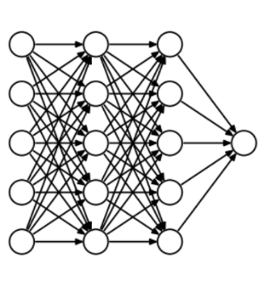
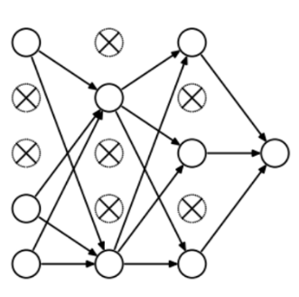
Dropout
During training there is some probability P for a neuron of the neural network to get turned off during training.
At every iteration, it randomly selects some nodes and removes them along with all of their incoming and outgoing connections
A simpler version of the neural network results in less complexity that can reduce overfitting

Slide 6
Convolutional Neural Networks

Slide 7
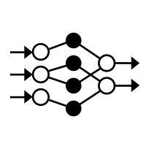
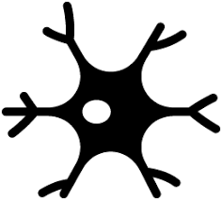


Neural Networks
Multilayer Perceptron
Convolutional Neural Networks (CNN)
Recurrent Neural Networks (RNN)
Simpler dataset (e.g. tabular dataset)
Too many weights/parameters for HD images
Disregards spatial information as it takes features as flattened vectors
Mostly used for image data, computer vision
Mainly for time series data (e.g. Natural Language Processing)
**Not covered in DL201+**

Slide 8




Convolutional Neural Networks
Effective for image recognition & classification
Takes an input image & assignts importance to various aspects/objects in the image
Differentiates features/objects from one another
Successfully capture spatial and temporal dependencies in an image through the application of relevant filters

Slide 9

The General Architecture

Slide 10

RGB images
RGB image separated by 3 colour panes - Red, Green, Blue
Convnets reduce images into a form which is easier to process without losing features necessary for good predictions

Slide 11

Convolution Layer - The Kernel (Filter)
5x5 Image (Green Channel)
Kernel - Responsible for carrying out convolution operation (Yellow)
Perform a matrix multiplication operation between K and the portion P of the image over which the kernel is hovering

Slide 12

Convolution Layer - 3 channels
What you’ve just seen is a one channel convolution, but remember images have 3 channels?
RGB images follow the same process, but kernel is 3D with 3 channels

Slide 13

3D convolution illustrations
Squashed one-depth channel Convoluted Feature Output

Slide 14
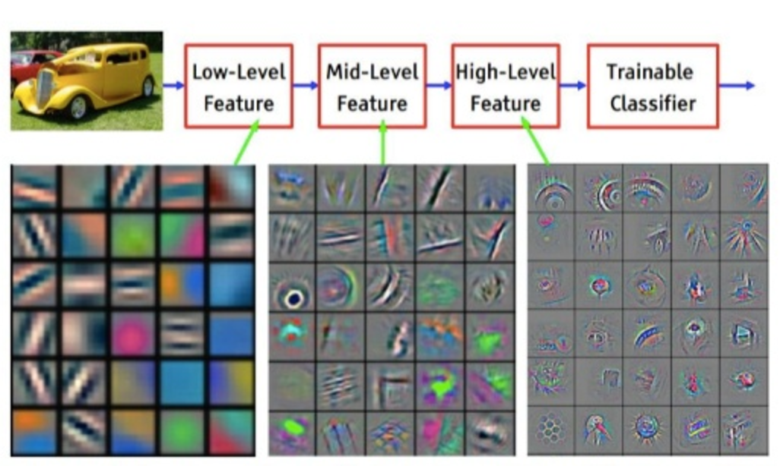
Features Extracted at each layer
Filters in first layer are responsible for capturing the Low-Level features such as edges, color, gradient orientation, etc.
Subsequent layers capture the High-Level features

Slide 15
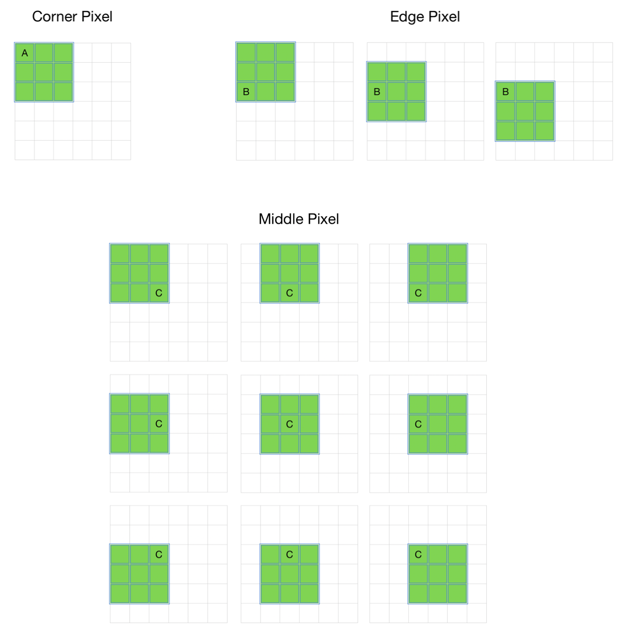
Padding
During convolution - Pixels on the corners and the edges are used much less than those in the middle
Information on borders of image not preserved as well as middle portion
Padding allows for more accurate analysis of image

Slide 16

Padding - Intuitions
Same Padding - Convolved matrix same dimensions as original image
Add layer of zero padding around image:
Applying 3x3x1 kernel results in convolved matrix of 5x5x1, same dimensions as original image
Valid padding - Perform convolution operation without padding
Basically doing convolution without any padding
There's no "made-up" padding inputs and the layer only uses valid input data.
5x5x1 → 7x7x1

Slide 17


Pooling Layers
Why add pooling layers?
Reduces the spatial size of the convolved feature
Decreases computational power required to process the data through dimensionality reduction
Normally used after each convolution layer
Max pooling: Maximum value from the portion of the image covered by kernel (More common)
Average pooling: Returns the average values from the portion of the image covered by kernel
Convolved Feature

Slide 18
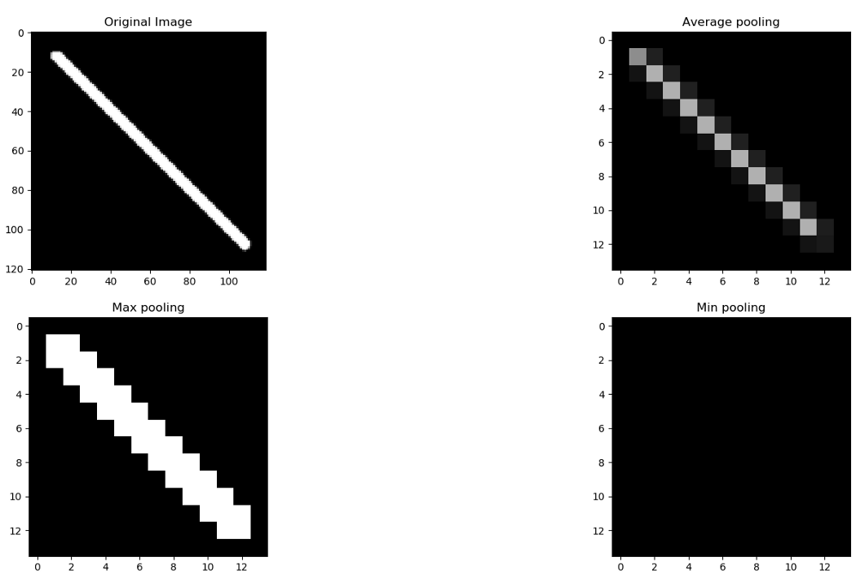
Pooling Layers
So which type of pooling do we use?
Cannot say that a particular pooling method is better over the other
Max pooling: Selects the brighter pixels from the image, and is useful when background of image is dark (e.g. MNIST dataset)
Average pooling: Smoothes out the image, and sharp features may not be identified when this pooling is used
** Max pooling more commonly used

Slide 19
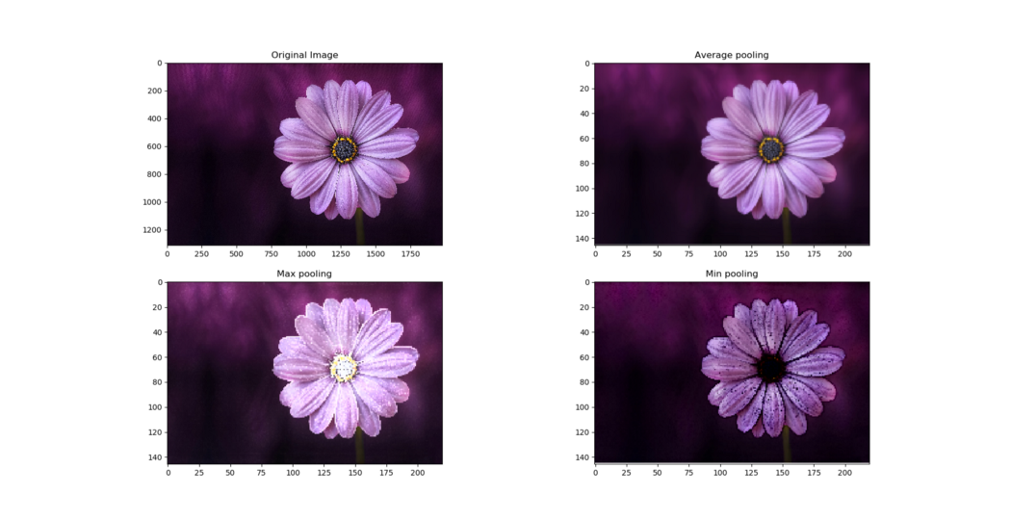
Pooling Layers

Slide 20



Fully Connected Layers
Way for learning non-linear combinations of the high-level features learned from output of the convnet
Image flattened into a column vector
Fed to a feed-forward neural network
Undergoes forward + backpropagation (Like a normal MLP)

Slide 21
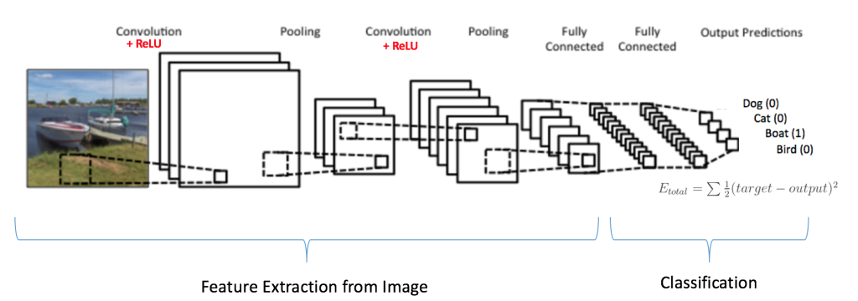
Summary of Convnets

Slide 22
The Problem of Deep Neural Networks

Slide 23

Problems with a very Deep Neural Network
There is a limit to the number of layers added that result in accuracy improvements
If we keep increasing the number of layers, accuracy will start to saturate at one point and eventually degrade
Result of problems with a deep neural network (e.g. vanishing gradients)
Might seem that shallower networks are learning better
E.g. 0.9^1000 (vanishing gradient) vs 1.1^1000 (exploding gradient)
Number gets smaller and smaller / bigger and bigger respectively, hinders gradient descent algorithm during backpropagation
Read more about vanishing gradients here: https://towardsdatascience.com/the-vanishing-gradient-problem-69bf08b15484

Slide 24
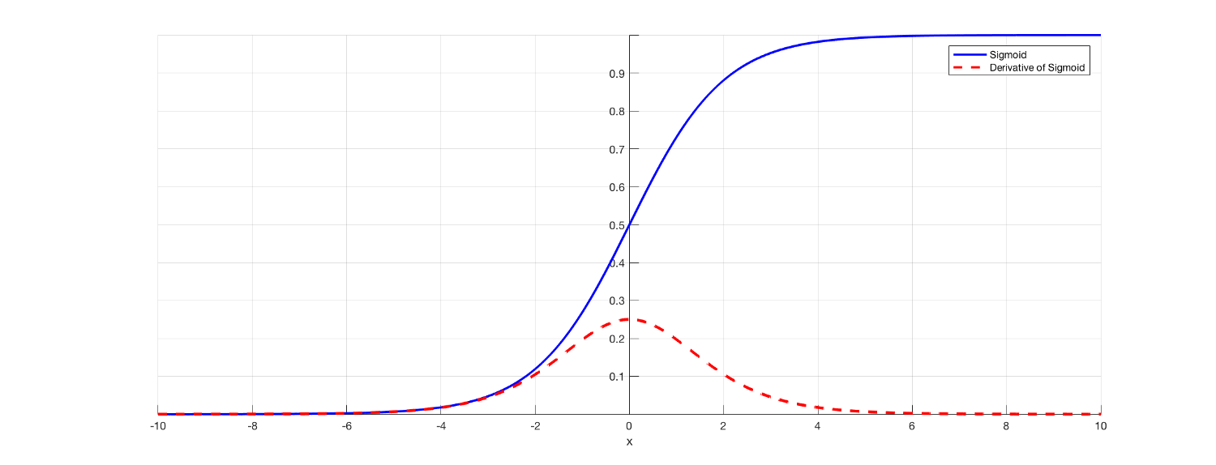
Sigmoid function and derivative
When inputs of the sigmoid function becomes larger or smaller (when |x| becomes bigger), the derivative becomes close to zero.
For shallow networks with only a few layers of activations, this is still ok. When more layers are used, causes the gradient to be too small for training to work effectively.

Slide 25
Some basic concepts first -
Batch Normalization

Slide 26




Batch Normalisation
Normalize the layers by adjusting and scaling the activations
Can choose layers to normalize
Done by subtracting the batch mean and dividing by the batch standard deviation
In-built pytorch function to normalise batches
Intuitions
May have some features from 0 to 1, and others 0 to 1000. If the input layer is benefiting from normalization, why not do the same thing also for the values in the hidden layers, that are changing all the time, and get improvements in training speed?

Slide 27

Batch Normalisation
Speeds up learning and therefore, training
Adds a bit of regularisation to each layer
Introduces a little bit of noise
Using a smaller batch size introduces more regularisation
Takeaway
At the end of the day, it’s an optimization to help train faster, so you shouldn’t think of it as a way to make your network better
Read up more of the side-effects of batch norm here: https://towardsdatascience.com/batch-normalization-8a2e585775c9

Slide 28




Bringing Batch Norm into context
For deeper networks, it becomes difficult to train when each layer relies on the distribution of activation in the previous layer
Use batch norm as a means of making each layer more independent
Train more easily
We will next explore how to further incorporate batch norm and convolutional neural networks to make deeper networks work better
Notes:
https://nenadmarkus.com/p/fusing-batchnorm-and-conv/

Slide 29
Residual Connections (RESNETs)

Slide 30
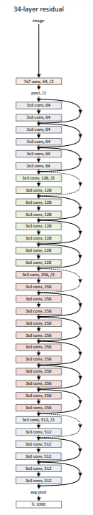
ResNets to the rescue!
Input
Output
Input
Output
Relu(Output + Input)

Slide 31
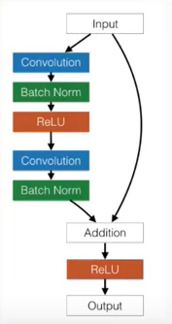
Each ResNet block (Add terms legend)
I
BN
A1
BN
O
Add (I+O)
A2
Final O
W1
W2
Relu(I + O)
Input → Image
Output → W2A1 → W2(W1*I1)
Relu(I+O) → Relu (Image + W2(W1*I1))
I: Input, O: Output
W1: Weight of 1st layer, W2: Weight of 2nd layer
BN: Batch Normalisation
A1: ReLu activation of 1st layer

Slide 32
ResNets
Reduce “depth” of the neural network
Allows for deeper training of the network
Can think of it as memory

Slide 33
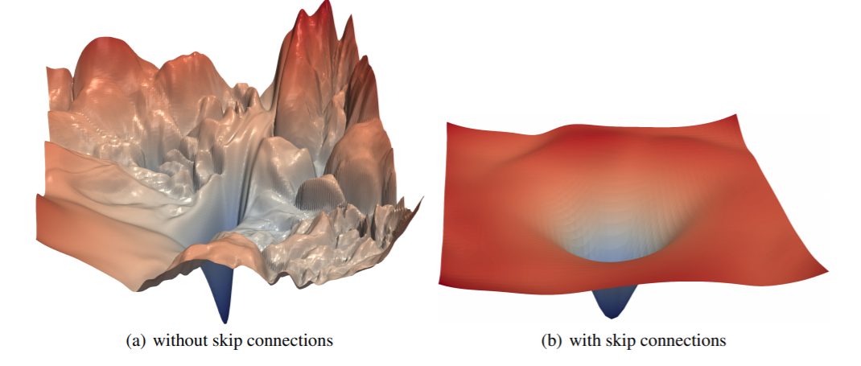
ResNet Loss Functions
Loss functions becomes smoother with skip connections
Less “spiky” → Easier to “traverse” through the loss landscape
Source: https://papers.nips.cc/paper/2018/file/a41b3bb3e6b050b6c9067c67f663b915-Paper.pdf

Slide 34
Cyclical Learning Rate

Slide 35
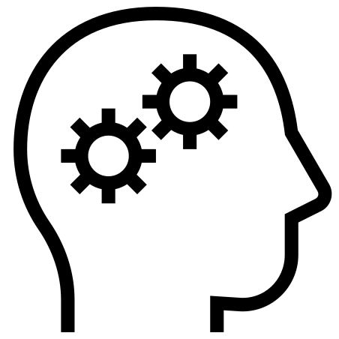
Learning Rate
Crucial hyperparameter to tune when training DNNs
Small learning rate → Very slow training
High learning rate → Hinder convergence, loss function fluctuates around minimum, or even diverges
Need to find the optimal learning rate to balance training speed and convergence

Slide 36
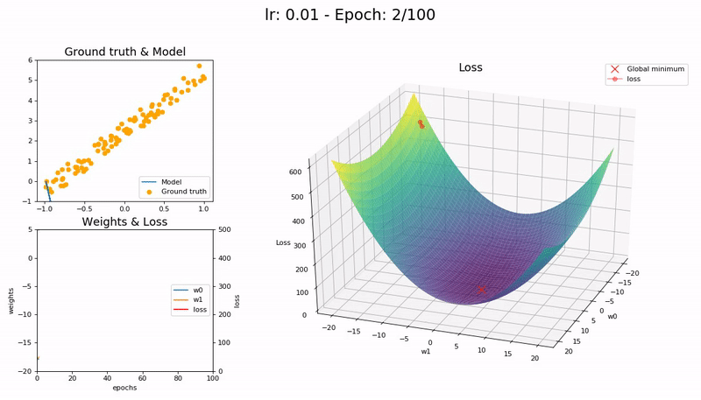
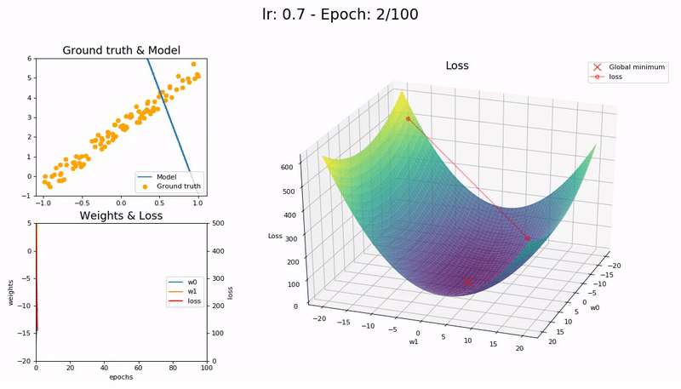

Too Low
Optimal
Too High

Slide 37
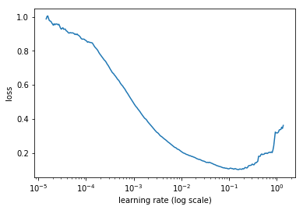
Finding optimal learning rate
Can manually try out each of the different learning rates, but it is time consuming
In practice, ideal learning rate is not static but changes as training progresses
Learning Rate to be selected corresponding to the steepest part of the graph (~10^-3)
Learning Rate Finder

Slide 38
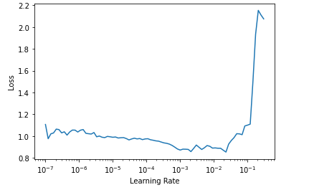
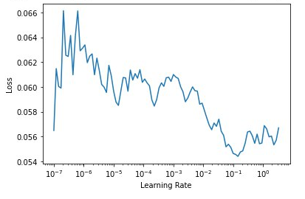
Messed up graphs for range test

Slide 39
Cyclical Learning Rate (CLR)
Instead of using fixed/decreasing learning rate, CLR method allows learning rate to oscillate between reasonable minimum and maximum bounds
CLRs are not computationally expensive
CLR eliminate the need to find the best learning rate value - the optimal learning rate will fall somewhere between the minimum and maximum bounds.
Produces overall better results
https://iconof.com/1cycle-learning-rate-policy/
https://sgugger.github.io/the-1cycle-policy.html

Slide 40
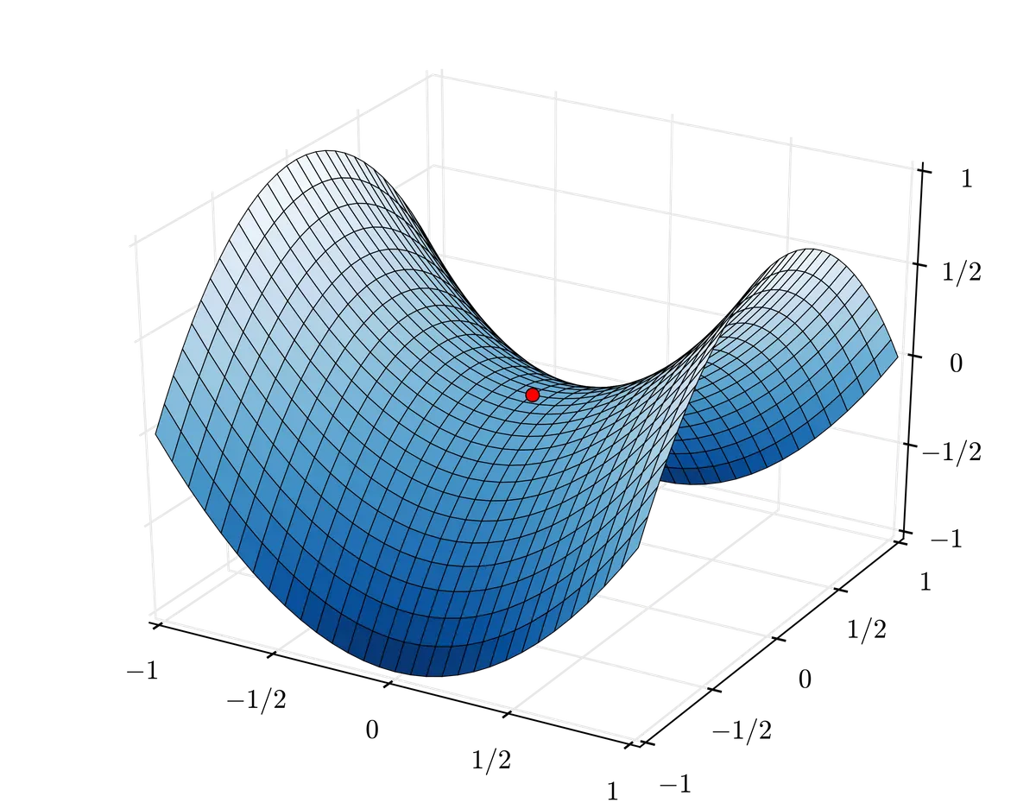
But why is it better?
Cyclical Learning Rates are effective because they can successfully negotiate saddle points, which typically have small gradients (flat surfaces) and can slow down training when learning rate is small.
The best way to overcome such obstacles is to speed up and to move fast until a curved surface is found. The increasing learning rate of CLRs does just that, efficiently.

Slide 41
But why is it better? (Not sure)
During the middle of the cycle, the high learning rates will act as regularization method, keeps the network from overfitting
Prevents the model to land in a steep area of the loss function, preferring to find a minimum that is flatter.
Last part of the training, with descending learning rates allows us to go inside a steeper local minimum inside that smoother part

Slide 42
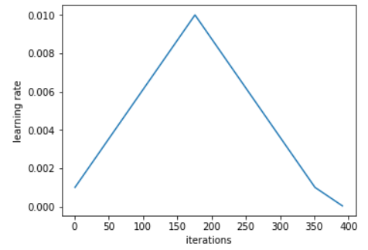
One Cycle Policy
Learning Rate Finder
Recommends to do one cycle with two steps of equal lengths with one going from a lower learning rate to a higher one than go back to the minimum
Maximum should be the value picked with the Learning Rate Finder, and the lower one can be ten times lower.
Length of this cycle should be slightly less than the total number of epochs
In last part of training, allow the learning rate to decrease more than the minimum, by several orders of magnitude.
CLR (One Cycle)

Slide 43



One Cycle Policy
Start
Middle
End
Uses a lower value for learning rate to warm-up the training
Learning rate reaches a maximum, serves as a regularisation method and prevents network from overfitting
Learning rate descends until annihilation, allows model to go into a steeper local minimum inside the smoother part

Slide 44
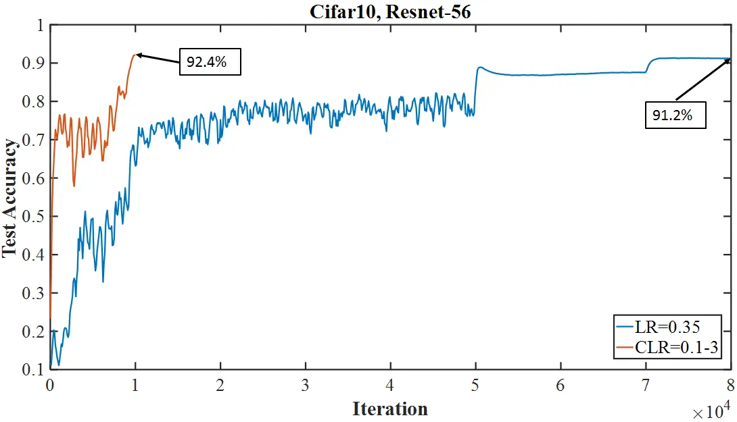

Slide 45
Implementation in fastai
Function: fit_one_cycle()

Slide 46
DATA AUGMENTATION

Slide 47


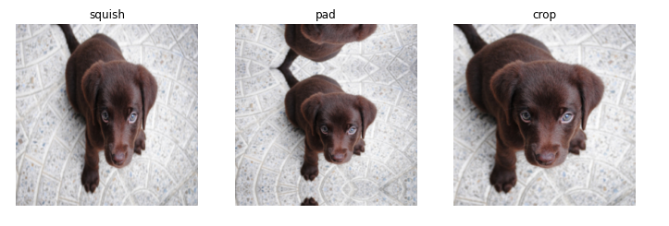
Almost as good as getting data for free
Horizontal flipping
Random Cropping

Slide 48
Rule 1: Always make sure your augmented data makes sense
Use tench example
Explore different methodologies of augmentation → PIL single step vs multiple transforms

Slide 49
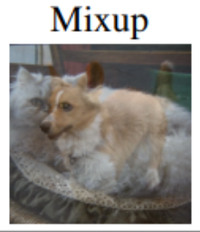
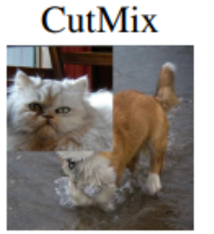
More advanced augmentations
*** Need to modify the loss function as well!!!

